Slide 1


Slide 2
Defending WebSockets
Security Issues & HTML5 WebSockets
Chase Schultz
University of Advancing Technology
Undergraduate Network Security

Slide 3
Introduction
University of Advancing Technology – http://www.uat.edu
Network Security Student
chaschul@uat.edu
[Buffer]Overflow – President And Founder - http://www.0x539.us
Security Researcher
f47h3r@0x539.us
TWITTER - @f47h3r_b0
GITHUB – https://github.com/f47h3r

Slide 4
Technical Background
Security Projects
Sweet Pickles
Crypto Wrapper
MS RPC Fuzzer
MFPDCB
Application Security Research
Reverse Engineering
Vulnerability Research
Exploit Development
Source Code Analysis
Experience
Stach & Liu – Web App Penetration Tester
[Buffer]Overflow – Security Research
Programming Projects – C/C++, Python, PHP

Slide 5
Agenda
Introduction / Background
What are WebSockets?
How WebSockets Work
WebSocket Security
Malicious WebSockets
Defending your Web Traffic

Slide 6
What are WebSockets?
HTML5 Websockets – RFC 6455 https://tools.ietf.org/html/rfc6455
Bidirectional – Full Duplex
Communication over HTTP
Asynchronous Data Transmisssion
Unlike typical HTTP Requests / Long Polling

Slide 7
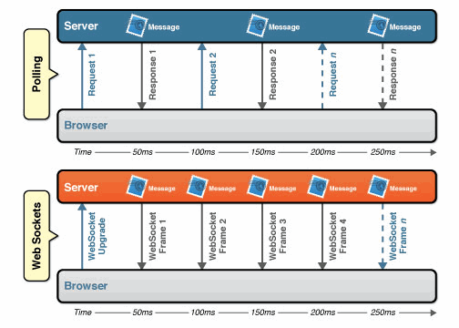
What are Websockets? (cont.)
Lots of Unneeded Overhead Here
Quick Realtime Data Flow

Slide 8
So What’s the Point?
Today people are realizing the demand for real-time data, whether it be streaming content, stock ticker applications, gps tracking information.
HTML5 Websockets are coming, major browsers (Chrome, Mozilla, and even IE) already support them.

Slide 9
WebSocket Security
Supports traffic over SSL/TLS
Strong Handshake Mechanism (SHA1)
Verified Origin Policy (When used with Browser)

Slide 10
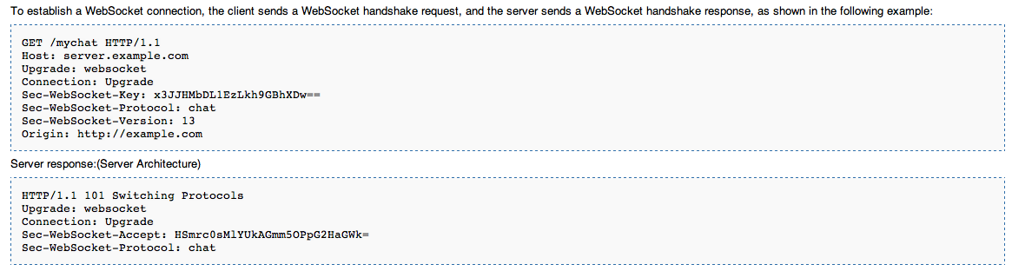
A Technical Look at WebSockets

Slide 11
Fun and Profit w/ WebSockets
Github: https://github.com/f47h3r/wsffap/

Slide 12
Egress Traffic
How many of you watch / filter egress traffic?
How many of you watch / filter
SSL/TLS traffic?

Slide 13
Other Projects that use WebSockets
HTML5 SIP Phone:
https://code.google.com/p/sipml5/
noVNC / libvncserver:
https://github.com/kanaka/noVNC
http://libvncserver.sourceforge.net
Web2Socket – WebSocket to TCP/IP Proxy:
https://code.google.com/p/web2socket (Early Dev)

Slide 14
Protecting Web Traffic
HTTP Headers
Length of Connections
SSL/TLS Proxy (Legal Implications)
Snort / IDS / IPS - Rule Sets

Slide 15
Slide Count
15

